Slide 1


Recipe Website
Designed and Developed by - Rohit Joshi, Shivam Kaushik and Abhinav Singh Bohra

Slide 2

Ingredient Alchemy.
Unlock the culinary possibilities at your fingertips with Ingredient Alchemy – where your kitchen dreams come true, one ingredient at a time. Search, discover, and create delicious recipes with the magic of your chosen ingredients.

Slide 3

Objectives of Ingredient Alchemy
1
Saves Time and Resources:
2
Facilitates Convenience:
Provide a time-saving solution for users who may not have the time or desire to shop for additional ingredients. Helps users reduce food waste by suggesting recipes that utilize ingredients nearing expiration.
Enables users to find recipes based on the ingredients they have readily available. Streamlines the cooking process by offering solutions for utilizing existing pantry items.

Slide 4
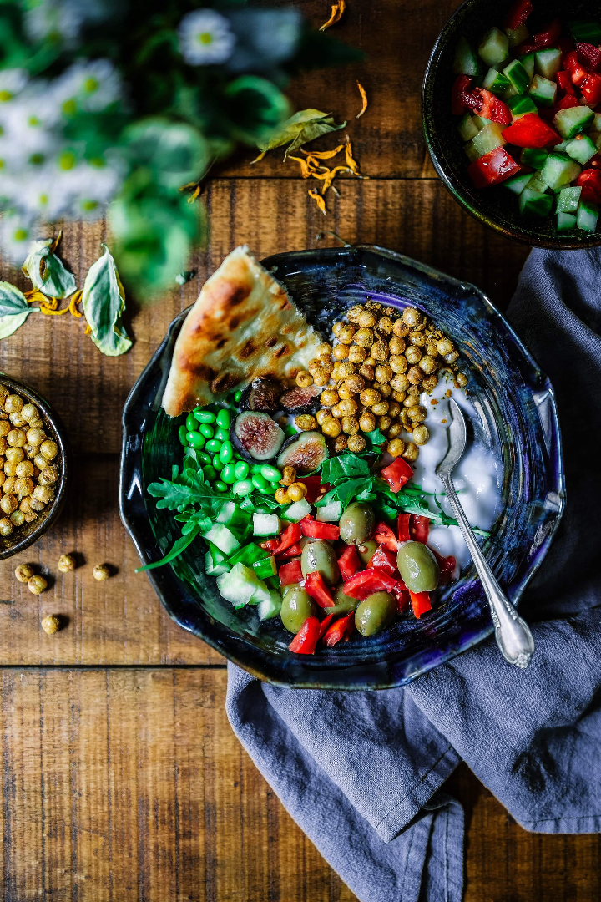

Project Overview
Background Information: Ingredients Alchemy tackles meal planning challenges in busy lifestyles, adapting to diverse diets, and reducing food waste by providing solutions for individuals facing time constraints and limited ingredient access.
Problem or Need: Traditional cooking involves planning meals based on recipes and buying ingredients, often inconvenient. Individuals seek a flexible, personalized solution that aligns with available ingredients, accommodating dietary restrictions, and promoting efficient meal planning by making the most of their kitchen resources.

Slide 5

Search Functionality
Allow users to enter keywords related to ingredients, cuisine, dish name, or dietary preferences.
Enable users to search for recipes based on specific ingredients they have on hand.
Display popular recipe categories prominently for users who prefer to explore recipes by category.

Slide 6
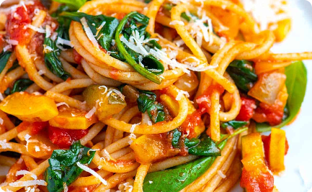
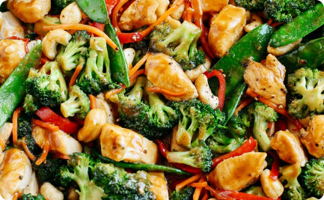
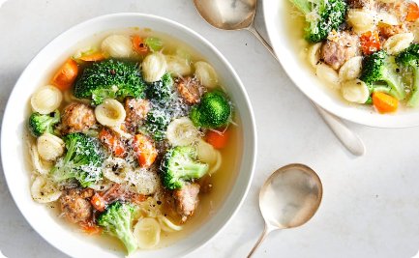
Recipe Categories
Non-Vegetarian
Healthy
Comfort Food
Explore a world of delicious dishes. From hearty mains to tempting desserts, our recipes will satisfy even the most carnivorous cravings.
Take care of your body and delight your taste buds with our collection of wholesome recipes. Discover nutritious meals that are as tasty as they are good for you.
Indulge in cozy and comforting dishes that warm your heart and soul. From creamy mac and cheese to soul-soothing soups, there's something for everyone.

Slide 7

Detailed Recipe Description
Experience the joy of cooking with our detailed recipe description. Each recipe includes step-by-step instructions, ingredient quantities, and useful tips. We provide everything you need for culinary success!

Slide 8
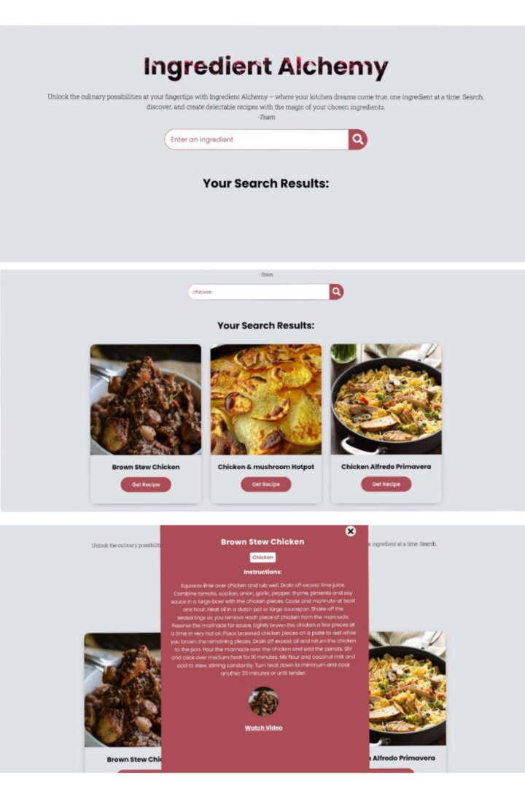
User Interaction
Three easy steps to find your recipe.
Open website.
Search Ingredient.
Get your recipe.

Slide 9
Our Website Features
1
Search Your Favorites
Search recipes to your personal Recipe Box for easy access.
2
Easy Steps To Follow
Search an ingredient in search box and get your detailed recipe description and easy steps to follow through.
3
Video Tutorials
Get access to simplified video tutorials on Youtube by expert chefs.

Slide 10

Technologies Used
1
HTML, CSS, JavaScript
2
Created a responsive user interface using HTML, CSS, and JavaScript.
3
Enabled interactive features for ingredient-based recipe search and meal planning using JavaScript.

Slide 11

About Us/Credits
Our Team
This website was designed and developed by Shivam Kaushik, Rohit Joshi and Abhinav Singh Bohra. We took inspiration for this website from https://youtu.be/opikz5x_1ak?si=LoLTa1szRjNdaoyJ.

